Slide 1

Defending and Securing Systems
Monitoring and Securing the DFI Environment

Slide 2
Securing a Computer System
Scenario:
Douglas Financials Inc (DFI from here forward) has experienced successful growth and as a result is ready to add a Security Analyst position. Previously Information Security responsibilities fell on our System Administration team. Due to compliance and the growth of DFI we are happy to bring you on as our first InfoSec employee! Once you are settled in and finished orientation we have your first 2-Weeks assignments ready.

Slide 3

Week 1

Slide 4
Connect - Instructions
All of the subsequent steps will take place in the DFI environment. Use the Windows 10 workstation to connect with the Windows server provided. [Please Provide Screenshots on the next slide as evidence that you completed this step.]

Slide 5
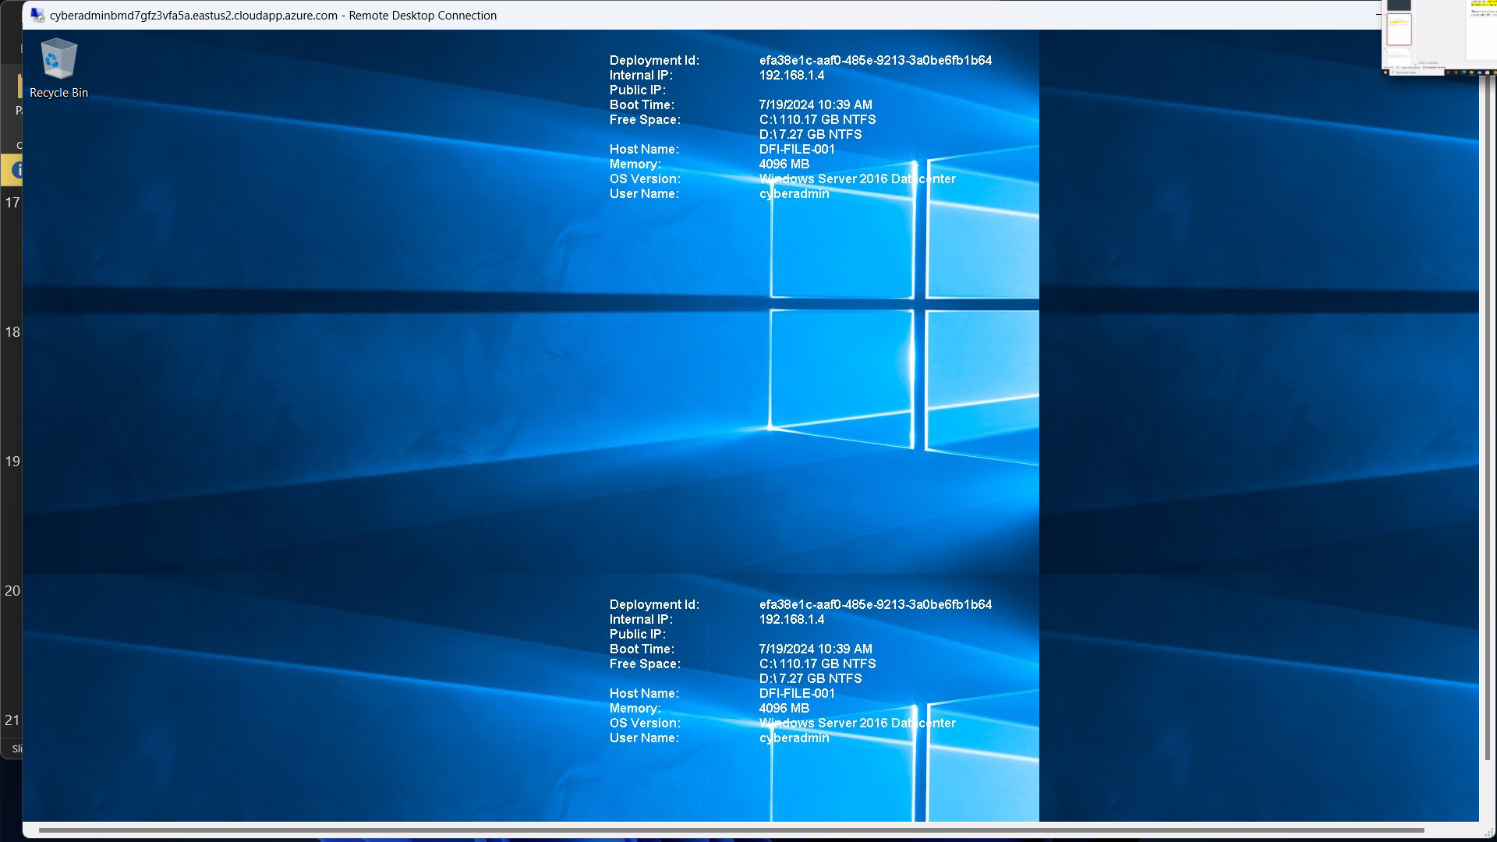
Connect - Evidence
[Please Provide Screenshots here as evidence that you completed the step listed on the previous slide. You may need to duplicate this slide to include all of your screenshots]

Slide 6
2. Security Analysis Instructions
DFI has an excellent SysAdmin team, but they have been focused on system reliability and scaling to meet our growing needs and as a result, security may not be as tight as we'd like. Your first assignment is to familiarize yourself with our file and application servers. Please perform an analysis of the Windows server and provide a written report detailing any security configuration issues found and a brief explanation and justification (5 sentences at least) of the changes you recommend. DFI is a PCI compliant organization and will likely be Sarbanes-Oxley in the near future. Use NIST, Microsoft, Defense-in-Depth, Principle of Least Privilege and other resources to determine the changes that should be made. Note changes can be to add/remove/change services, permissions and other settings. Defense-in-Depth documentation. NIST 800-123 (other NIST documents could also apply.) Looking at the following requirements, specifically: Folder Permissions (that are incorrectly granted) Roles Changes (disabled/enabled) Services changes (disabled/enabled) Tip: Do not miss the security permissions on the HR Directory. Write your analysis on the next slide.

Slide 7
2. Security Analysis Evidence
Write your analysis below.
1 | *The server did not get the latest patch updates *The server didn’t get the latest system update (may be vulnerable) *The server doesn’t have a secondary layer of an antivirus software * The service called “server” is enabled which is unused on the server disabling it will give the server a great impact Turing off the service “DeviceAssociationService” will give an impact for the server performance There was nothing malicious found in the users permissions IT and HR folders are set to be read and chanfe by every one which makes a problem in the integrity of the data.

Slide 8
3. Firewall Rules - Instructions
DFI does not have a dedicated networking department just yet, once again these tasks normally fall under the SysAdmin group. Now that we have you as a security professional, you'll take over the creation of our firewall rules. We recently entered into a new partnership and require new IP connections. Using Cisco syntax, create the text of a firewall rule allowing a new DFI partner WBC International, access to DFI-File-001 & DFI-File-002 access via port tcp-9082. The first partner's IP is 21.19.241.63 and DFI-File-001's IP is 172.21.30.44. The second partner's IP is 21.19.241.64 and DFI-File-002's IP is 172.21.30.45. For this exercise assume the two IP objects have not been created in the firewall. Note* Use DFI-Ingress as the interface for the rule. For documentation purposes, please explain in 2-3 sentences the syntax for non-technical management on the change control board that meets weekly. Write the text of your firewall rule and explanation on the next slide.

Slide 9
3. Firewall Rules - Evidence
Write the text of your firewall rules and explanation below.
 | name 21.19.241.63 Part1 name 172.21.30.44 File1 access DFI-Ingress extended permit tcp host Part1 host File1 eq 9082 // this rule is used allow partner WBC International to connect to DFI-File-001 name 21.19.241.64 Part2 name 172.21.30.45 File2 access DFI-Ingress extended permit tcp host Part2 host File2 eq 9082 // this rule is used allow partner WBC International to connect to DFI-File-002

Slide 10
4. VPN Encryption Recommendation Instructions and Evidence
DFI is creating a payroll processing partnership with Payroll-USA, this will involve creating a VPN connection between the two. Research, and in in 3 to 5 sentences, recommend and justify an encryption solution for the connection that is using the latest available encryption for Cisco. Use the Cisco documentation as a guide
 | 1-(SHA256) Number one recommendation will be the SHA256 as It is a combination between high security and fast transporting speed of data. 2-(AES) Second recommendation will be the AES as it is highly secure but a little bit slower than SHA256.

Slide 11
5. IDS Rule - Instructions
The System Administrator gave you a heads up that DFI-File-001 with an IP address of 172.21.30.44 has been receiving a high volume of ICMP traffic and is concerned that a DDoS attack is imminent. She has requested an IDS rule for this specific server. The VoIP Administrator is also concerned that an attacker is attempting to connect to her primary VoIP server which resides at 172.21.30.55 via TFTP. She has requested an IDS rule for this traffic. Port no69 For documentation purposes, please explain the syntax in 3-5 sentences for non-technical management on the change control board that meets weekly. Write your answers on the next slide.

Slide 12
5. IDS Rule - Evidence
Write your answers below.
 | alert icmp any any -> 172.21.30.44 any (msg:"High volume ICMP traffic to DFI-File-001 - Possible DDoS"; sid:1000001;) This rule generates an alert for any ICMP traffic (commonly ping requests) directed towards the server with IP address 172.21.30.44.
 | alert udp any any -> 172.21.30.55 69 (msg:"TFTP connection attempt to VoIP server"; sid:1000002;) This rule generates an alert for any UDP traffic attempting to connect to port 69 on the server with IP address 172.21.30.55.

Slide 13
6. File Hash Verification - Instructions
A software vendor has supplied DFI with a custom application. They have provided the file on their public FTP site and e-mailed you directly a file hash to verify the integrity and authenticity. The hash provided is a SHA256. Hash: 7805EC4395F258517DFCEEED2B011801FE68C9E2AE9DB155C3F9A64DD8A81FF6 Perform a file hash verification and submit a screenshot of your command and output. The File is stored on the Windows 2016 Server in C Drive under DFI-Download. [Place your screenshot verification on the next slide.]

Slide 14
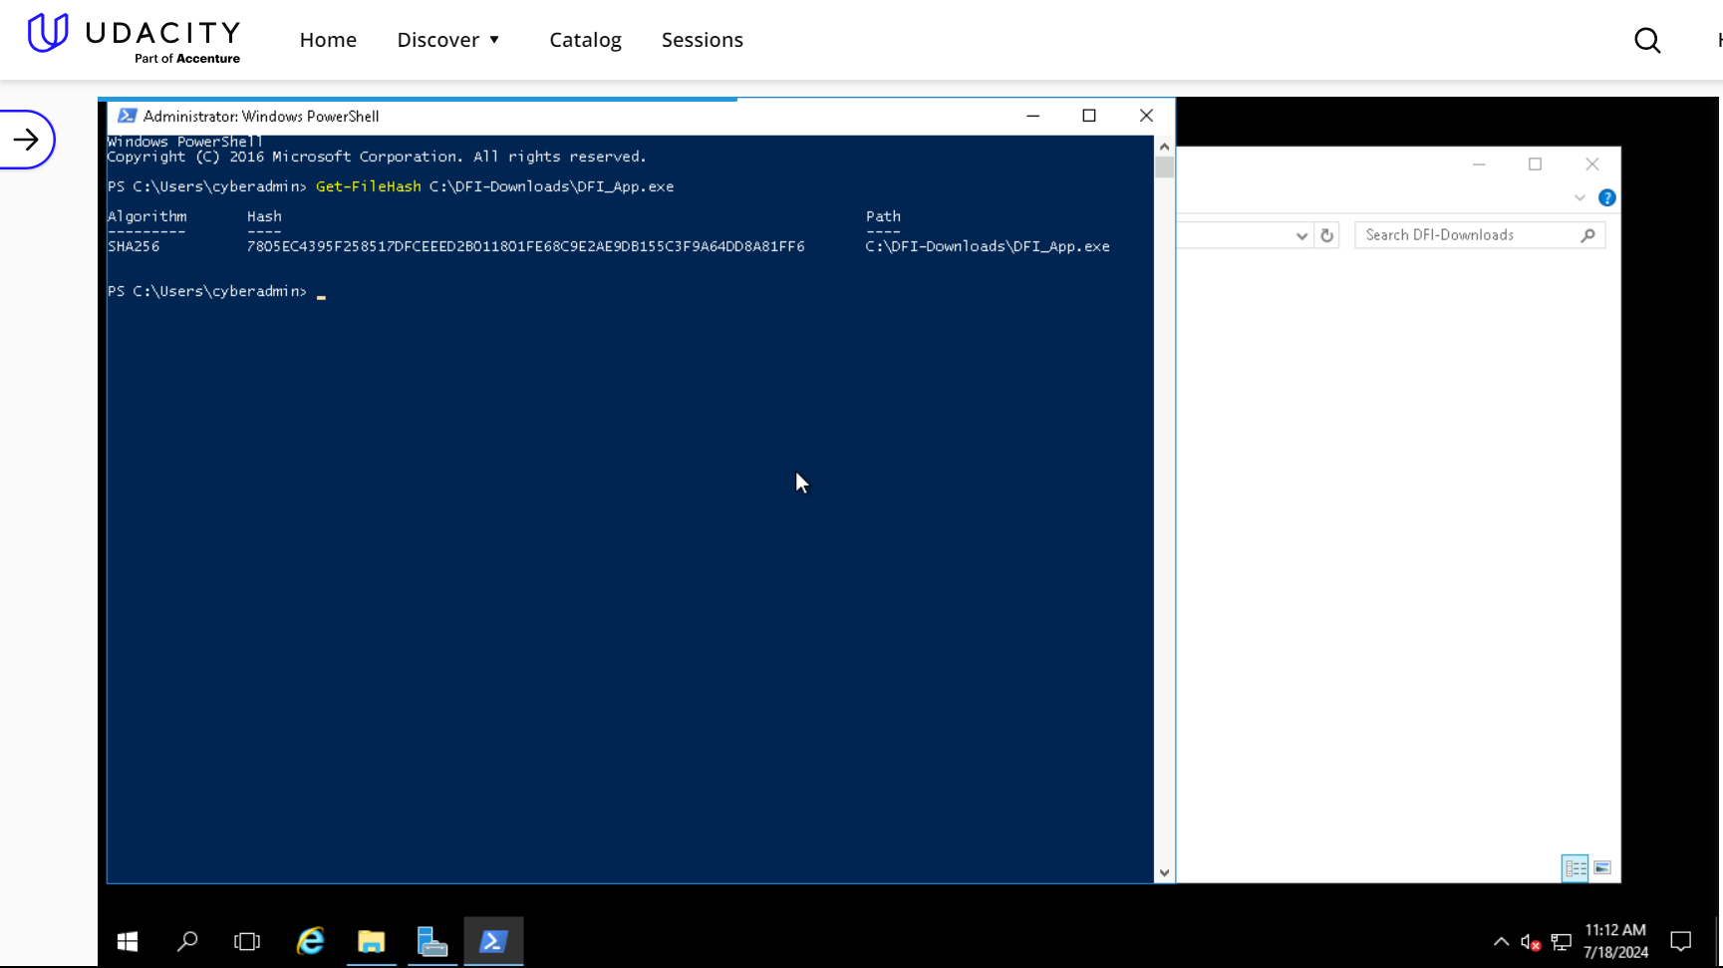
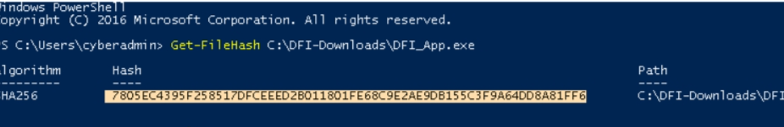
6. File Hash Verification
Place your screenshot verification below. 7805EC4395F258517DFCEEED2B011801FE68C9E2AE9DB155C3F9A64DD8A81FF6

Slide 15
Week 2

Slide 16
7. Automation - Instructions
Now that you've performed a light audit and crafted Firewall and IDS Signatures we're ready for you to make some additional recommendations to tighten up our security. The IT Manager has tasked you with some introductory research on areas that could be improved via automation. Research and recommend products, technologies and areas within DFI that could be improved via automation. Recommended areas are: SOAR products and specifically what could be done with them Automation of mitigation actions for IDS and firewall alerts. Feel free to elaborate on other areas that could be improved. Complete the chart on the next slide including the area/technology within DFI and a proposed solution, with a minimum of 3 areas. Provide a brief explanation (at least one sentence each) for your choices.

Slide 17
7. Automation - Evidence
Complete the chart below.
 | DFI Area/Technology | Solution | Justification for Recommendation
 | Automation of IDS and Firewall Alerts (IPS) | Cisco SecureX, IBM QRadar | Automating responses to IDS and firewall alerts ensures immediate action against potential threats, reducing the risk of human error.
 | SOAR (Security Orchestration, Automation, and Response) | Splunk Phantom, XSOAR | SOAR platforms ease incident response by automating repeated tasks, enabling faster threat mitigation and improving the efficiency of security
 | Patch Management | Ivanti Patch, SolarWinds Patch Manager | Automating patch management processes with a Patch Manager ensures timely deployment of security patches, reducing vulnerabilities and enhancing system security.

Slide 18
8. Logging RDP Attempts - Instructions
The IT Manager suspects that someone has been attempting to login to DFI-File-001 & DFI-File-002 via RDP. Prepare a report that lists unsuccessful attempts in connecting over the last 24-hours & 12 hours respectively. Using Powershell or Eventviewer, search the Windows Security Log for Event 4625 & 4626 respectively. Export to CSV. For your deliverable, open the CSV with Notepad and take a screenshot from your personal computer for your explanation. Then in 3-5 sentences, explain your findings, recommendations and justifications to the IT Manager. Place your screenshot on the following slide and the explanation on the slide after your screenshot.

Slide 19
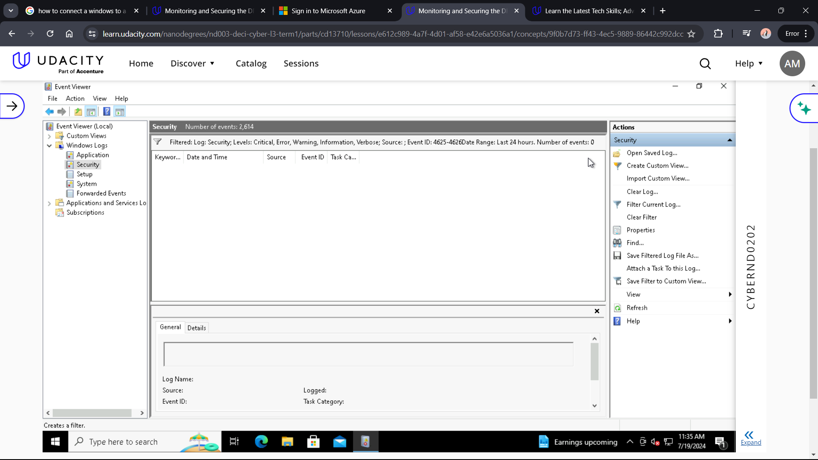
8. Logging RDP Attempts - Evidence
Place your screenshot below There was not any events found on the machine.

Slide 20
8. Logging RDP Attempts - Evidence
Write your 3-5 sentence explanation of your findings, recommendations, and justifications to the IT manager below.
 | There was nothing found so there would not be recommendation

Slide 21
9. Windows Update - Instructions and Evidence
Using NIST 800-40r3 and Microsoft Security Update Guide, analyze the windows servers and provide your answers in the table below of available updates (KB and CVE) that should be installed as well as any updates that can be safely ignored for DFI's purpose. To assist, be aware that DFI is concerned with stability and security, any update that is not labeled as a 'critical' or 'security' can be left off. In the table below list at least 3 updates that should be installed and 3 updates that are not necessary.Justify your recommendations as to why you are making your choices. Tip: The severity of the updates can also help you decide the updates you’d like to install or ignore.
 | Available Updates | Update or Ignore? | Justification
 | Win 10 malicious software removal (KB890830) | Update | Its important for protecting device from malwares
 | NetFrameWork (KB5011048) | Ignore | It may not be critical to update the .netframework
 | Windows Server 2016 (KB5040434) | Update | As it have been marked as Important
 | Comulative update win 10 (KB5040427) | Ignore | As it is not marked as Critical or Security
 | Comulative update windows 10 (KB4023057) | Ignore | As it is not marked as Critical or Security
 | Win server 2016 malicious software removal (KB890830) | Update | Its important for protecting device from malwares (marked as Security)

Slide 22
10. Firewall Alert Response - Instructions and Evidence
The IT Manager took a look at firewall alerts and was concerned with some traffic she saw, please take a look and provide a mitigation response to the below firewall report. Remember to justify your mitigation strategy in 3 - 5 sentences. This file is available from the project resources title: DFI_FW_Report.xlsx. Please download and use this file to complete this task.
1 | Firewall mitigation response and justification goes here Make a firewall rule that blocks every connection that has been detected as a brute force Make the max tries of entering the password is 6 tries by standard Make ips prevent Consecutive password failes by the same ip in a short time.

Slide 23
11. Status Report and Next Steps - Instructions
As your first two weeks wind down, the IT Manager, HR Manager as well as other management are interested in your experience. With your position being the first dedicated Information Security role, they would like a 'big picture' view of what you've done as well as the security posture of DFI. Similar to Defense-in-Depth, an organization has multiple layers of security from the edge of their web presence all the way to permissions on a file. In 6-8 sentences, explain the work you've done, the recommendations made and how DFI should proceed from a security standpoint. This is your opportunity to provide a thoughtful analysis that shows your understanding of Cyber Security and how all of the tasks you've performed contribute to the security of DFI. As this will be reviewed by non-technical management please keep the technical jargon to a minimum. [Provide your Status Report on the next slide.]

Slide 24
11. Status Report and Next Steps - Instructions
[Provide your Status Report below.]
1 | I made an RDP connection between the win 10 machine and the win server 2016 machine, I also made a firewall rule allowing the partners to connect to the 2 DFI files, I created 2 IDS rules to to detect VoIP requests and to detect high ICMP traffic (D-Dos Attack). I suggested VPN Encryption methods based on their advantages and check a file integrity using SHA 265. I also recommended some Automation to decrease human error and a firewall recommendation according to the DFI FW report and making the needed updates for the machines to run at best performance

Slide 25
12. File Encryption
As your final task, assemble all of the deliverables you have created in Steps 1-12 and encrypt them using 7zip with a strong password. Password complexity: 15 or more characters and a combination of alphanumerics and special characters. When you submit the file you must also include your password as a note to the reviewer at Udacity or they will not be able to review your project.

Slide 26
Standout Suggestions

Slide 27
Standout Suggestion 1
1 | Users have a unique password on the server using (MFA)

Slide 28
Standout Suggestion 2
2

